Slide 1
Return rate & Profitability analysis
Presented by chaitra v l

Slide 2
agenda
Introducing yourself
Data fields
Basic queries
Basic exploratory data analysis
Business centric questions and queries
Statistical analysis
Key business insights & recommendations
conclusion

Slide 3
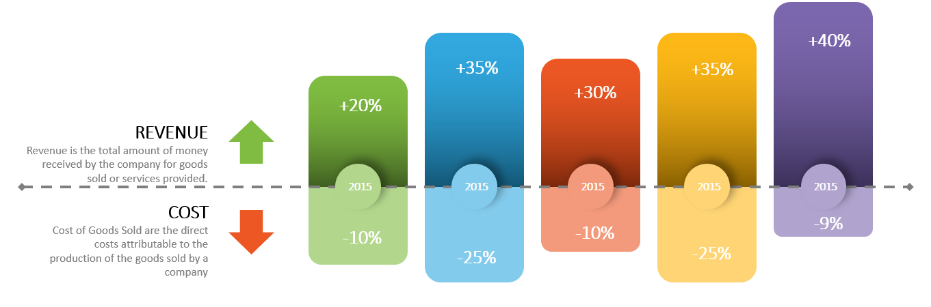
introduction
Turning raw data into actionable business insights.
Today, I'm excited to present one of my recent projects where I analyzed sales, profit, discount patterns, and return behavior to answer key business-centric questions.
The goal is to highlight areas of improvement and suggest data-driven actions for better profitability and efficiency

Slide 4
“the goal is to turn data into information, and information into insight.”
– carly fiorina, former CEO of hewlett-packard

Slide 5
Data fields
ORDERs: Order Id, sales, discount, profit, product name, product category, product sub-category, customer name, region, state, city.
Returns: order id, return status.
Orders table contains more than 9k rows,
Returns table contains more than 1k rows.

Slide 6
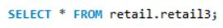
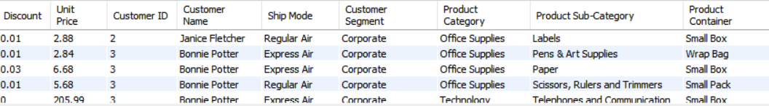
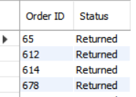

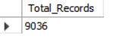
Retrieving all columns
Retrieving all columns to understand the full structure and content of the orders and Returns table.
Total Number of Records
There is 9036 records in the dataset.
Basic Queries

Slide 7
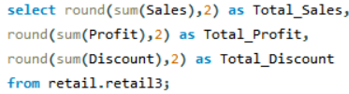
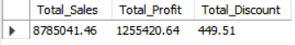
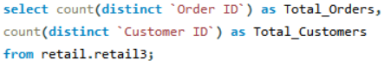
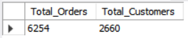
Basic Exploratory data analysis
Overview: Total sales, Profit, Discount
Total Number of Orders and Customers

Slide 8
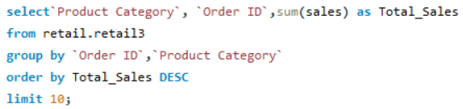
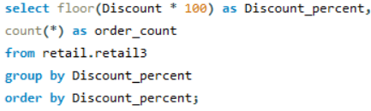
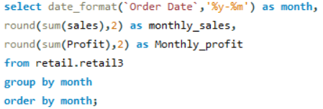
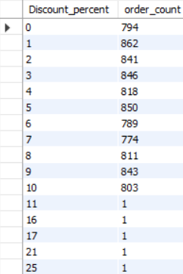
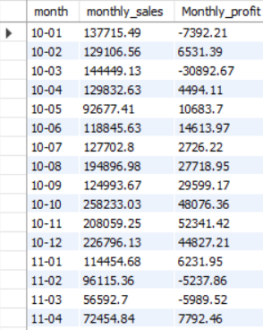
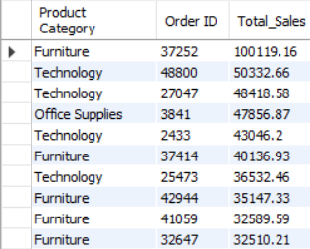
Top 10 products category by sales
Discount Distribution
Monthly sales and profit trend

Slide 9
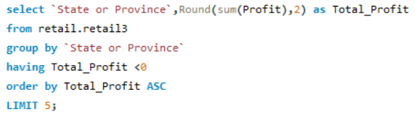
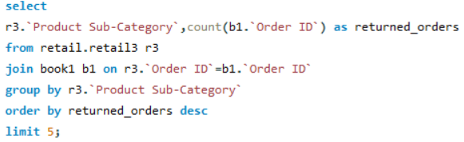
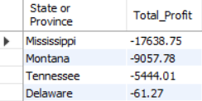
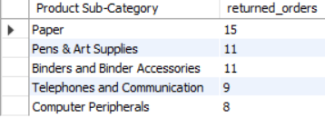
Top 5 States by Negative Profit
Top 5 Most returned sub-category

Slide 10
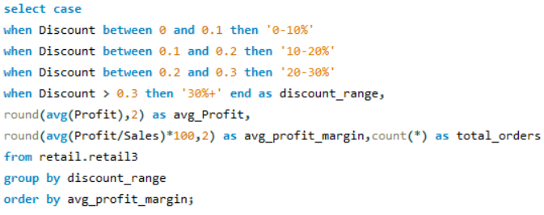
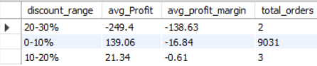
EDA- Business-Centric Questions & Queries
1) Which discount ranges are associated with negative profit margins?
The analysis revealed that higher discounts are linked to negative profit margins. Specifically, orders with a 20-30% discount had the lowest profit margins, followed by those in the 0-10% and 10-20% ranges. This means offering larger discounts may be hurting profitability, and we should be cautious when setting discount strategies.

Slide 11
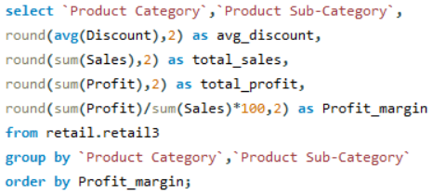
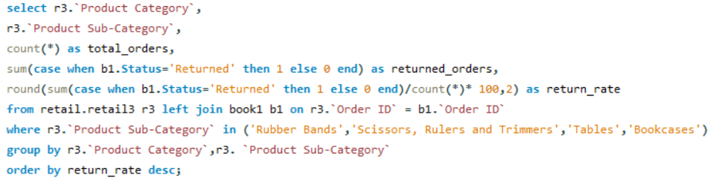
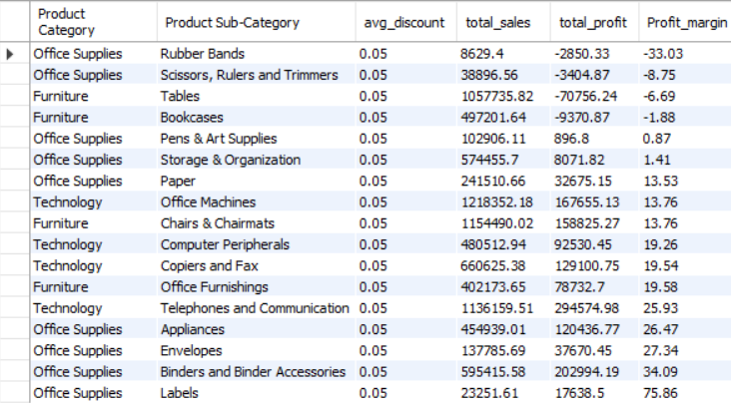
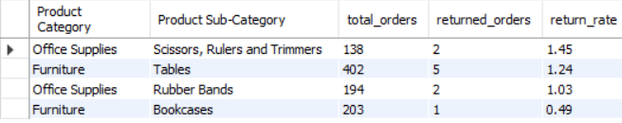
2) What are the average discount and total profit margin by product category?
I observed that the first four product sub-category in output had negative profit margins. To investigate further, I analyzed the return rate for these categories- since high return rate often lead to loss due to refund costs, damaged goods. The analysis revealed significantly high return rates in these categories(e.g., Scissors, Rulers, Trimmers had a 1.45% return rate, Tables had a 1.24%), suggested a strong correlation between returns and negative profit.
By identifying that more than 1 out of every 100 orders in these categories gets returned, we can target interventions that could reduce return-related losses and potentially recover up to 5-10% of the lost margin.

Slide 12
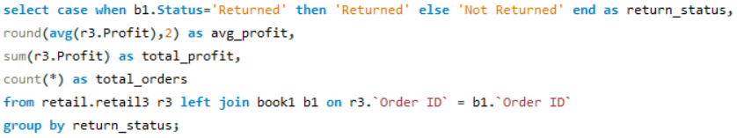
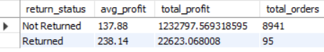
3) Do returned orders show negative profit? I looked into whether returned orders lead to losses. Returned orders do not show negative profit – they have a higher average profit (238.14) compared to non-returned orders (137.88). This suggests the return process is currently well-managed and not hurting profitability.

Slide 13
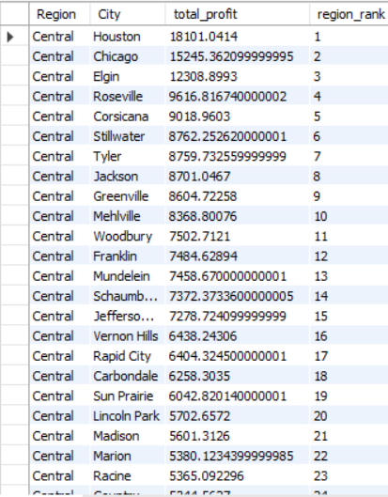
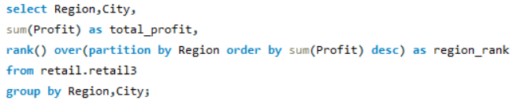
4) Which cities in each region are most and least profitable? This helps us identify which cities are contributing most to the company's profitability – and which ones are underperforming. In the central region: * Houston is the top-performing city, generating the highest total profit. * on the other hand, cities like Racine and Marion are at the bottom of the list, contributing the least profit in the region. This kind of ranking helps business teams focus efforts – such as boosting marketing or reviewing operations – in cities that are underperforming compared to others in their region.

Slide 14
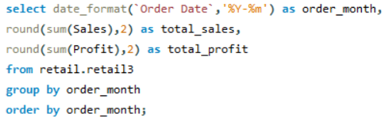
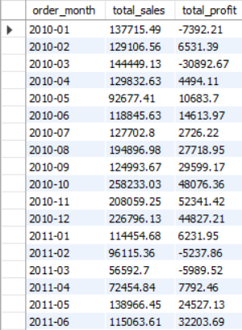
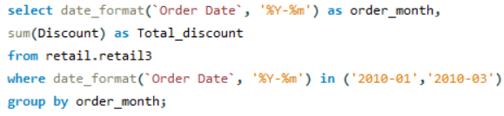
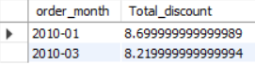
5) Are we growing profitably? I analyzed our monthly sales and profit trends. * In early 2010, we saw mixed performance. Jan had high sales but resulted in a loss of –7,992 in profit. * By march 2011, we had both higher sales and a strong profit, showing clear improvement. Why I analyzed total discount? This was important to check if high discounting was hurting our profits-especially in months where sales were strong but profits were low. * Discounts might have contributed to early losses, but profitability improved in later months-even as sales continued to grow.

Slide 15
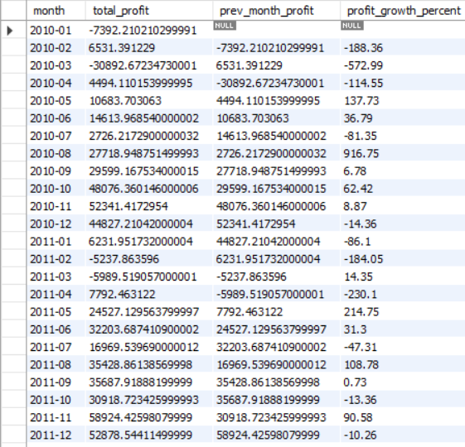
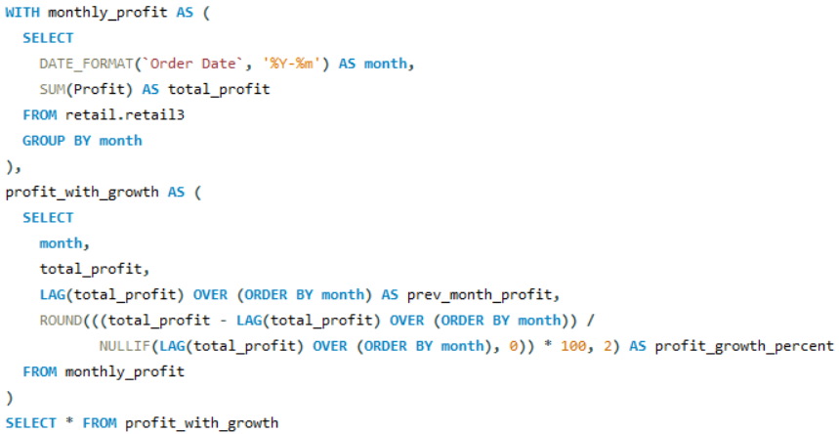
6) month over month growth in profit. To track our financial progress, I calculated the month-over-month profit growth percentage. This tells us how much our profit increased or decreased compared to the previous month. Overall, the trend shows fluctuations in profit growth, with some moths seeing sharp gains and others showing decline. This view helps management understand not just total profits, but the direction and pace of growth, allowing us to respond quickly to both opportunities and risks.

Slide 16
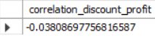
Statistical analysis
7) Is there a strong correlation between discount and profit?
Correlation helps us understand whether two things move together – in this case, when discounts go up or down, do profits go up or down too?
Since the correlation is close to 0, we can say that there is no strong relationship between the amount of discount given and the profit made.

Slide 17
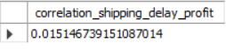
8) Are late shipments correlated with lower profit?
Since 0.015 is very close to zero, it means there is no meaningful relationship between shipping delays and profit.

Slide 18
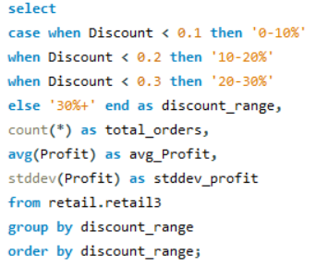
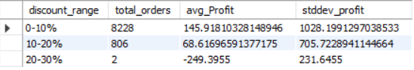
9) What is the average profit per discount level bucket?
Orders with low discounts(0-10%) resulted in highest average profit.
As the discount increased, the average profit decreased and in the 20-30% range, there was actually a loss on average.
Most of the sales happened with lower discounts, which are also more profitable.
This suggests that offering higher discounts may hurt profits, and limiting discounts could be better for the business.

Slide 19
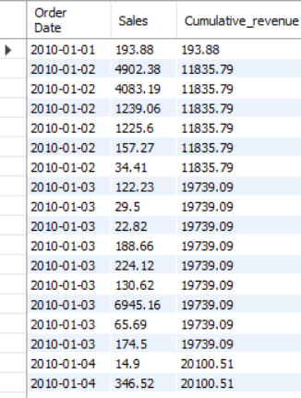
10) Cumulative revenue generated
This helps track how revenue is growing over time. Its especially useful to identify periods of fast growth or stagnation and to measure performance over time.
On Jan 1, 2010, revenue started at $193.88.
By Jan 4, 2010, total revenue had grown to over $20,100.
This means the business generated over $20k in sales within just the first few days.

Slide 20
Key business insights & Recommendations
The most frequently sold products are popular and have consistent customer demand. Ensure these products are always in stock.
Certain categories like electronics, furniture etc., generate the highest revenue. Identify underperforming categories for potential discounting or discontinuation.
A small segment of customers may be driving a large portion of revenue. Create loyalty programs for top customers.
Not all high-selling items are high-profit items. Promote product with high profit margins.
Most profit comes from a specific set of product categories and region so focus sales and marketing on these high-performing product segments to maximize profit.
Giving bigger discounts usually leads to lower profits. Review discount strategies to avoid hurting profitability-offer them more strategically.
Frequent delays may be slightly affecting profits. Improve logistics and delivery timeline to protect revenue.
No discount yields highest profit. Limit high-discount campaigns and promote full-price or low-discount sales.
Growth is on track – maintain current momentum by optimizing high-performing areas and fixing minor inefficiencies.

Slide 21
conclusion
The retail data analysis provides a clear picture of what’s driving the business forward. High-performing products and regions reveal where demand is strongest. By addressing underperforming areas and optimizing inventory and pricing strategies, the business can improve profitability. Our analysis reveals that while revenue is growing steadily, profit margins are sensitive to high discount levels and delayed shipments. Discounts, when not applied strategically, significantly reduce profitability. Leveraging these insights empowers smarter, data-driven decisions for sustainable growth.

Slide 22

GitHub Link: https://github.com/chaitra-vl-11 Portfolio Link: https://www.datascienceportfol.io/chaithravlc LinkedIn Link: https://www.linkedin.com/in/chaitra-vl Email Address: chaithravlc@gmail.com

